Slide 1





The Rise And Fall Of MySpace
Venkata Praveen Mannepalli Rajdeep Bhattacharya
Course :- Advanced Database Systems
Instructor :- Prof. Barun Chandra
Course ID :- CSCI-6624-02
Session :- Fall 2023

Slide 2
The Rise And Fall Of MySpace Venkata Praveen Mannepalli Rajdeep Bhattacharya Course :- Advanced Database Systems nstructor :- Prof. Barun Chandra Course ID :- CSCI-6624-02 Session :- Fall 2023

Slide 3

The Story So Far...

Slide 4

Motivation
I have used myspace in late 2000s. It certainly vanished from pop agenda, from the limited online eyesight.
It didn’t feel much, no jerks perceived.
Cut to 2021 – I was doing a preparation and recapitulation course for engineers from a now well know Indian online academy. While talking about load balancers and all the instructor mentioned the issue of myspace. That’s when I came to know the interesting case story that myspace is.

Slide 5
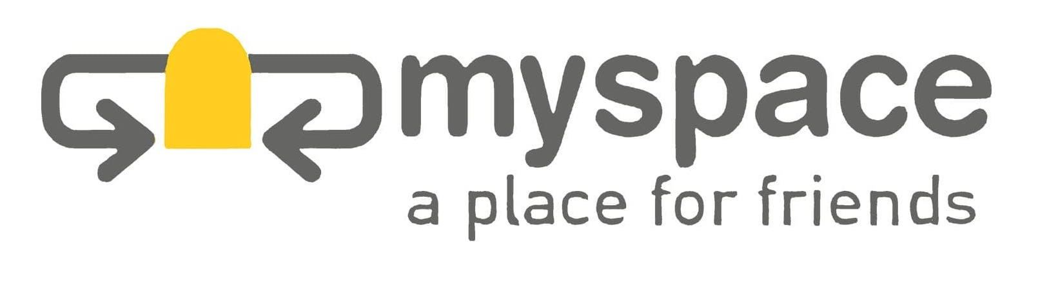
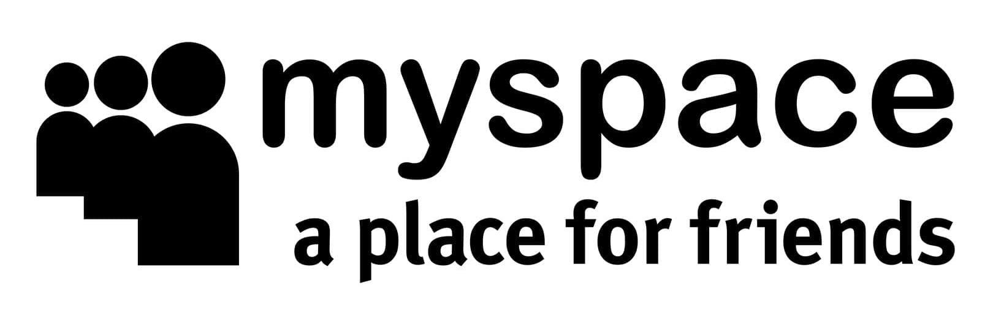
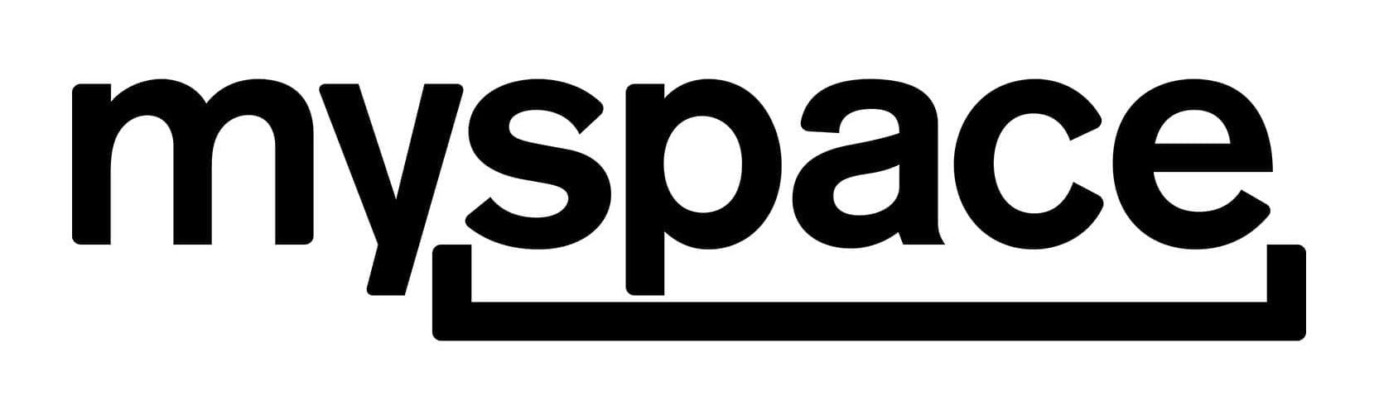
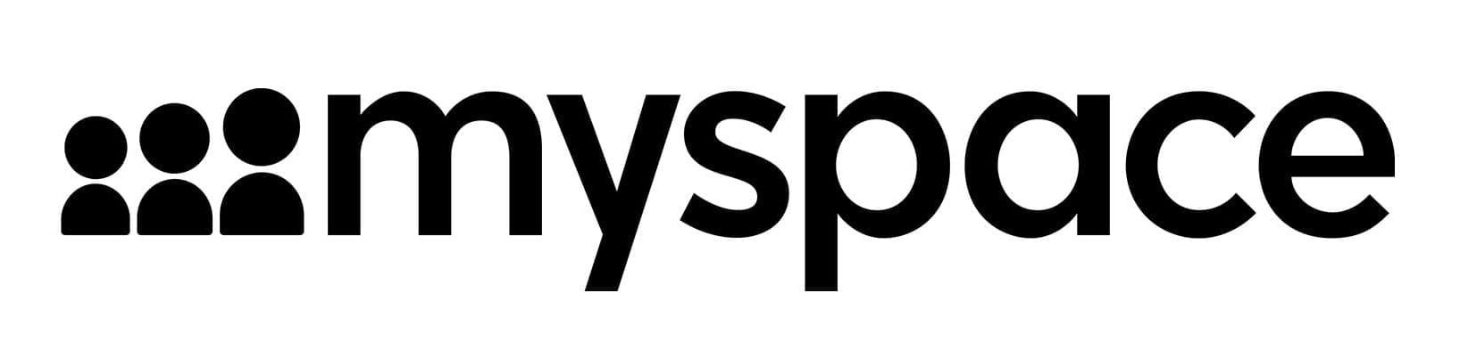
The Journey Of MySpace Through Its Logos Over The Years
2003
2004
2010
2012

Slide 6
A Brief History: The In-Thing Of The 2000s
Like it has been said earlier the rise of MySpace can be attributed to timing and accessibility. The platform was launched in 2003 and was one of the first social media sites. MySpace offered a service that was non-restrictive, it let users customize their own pages, and also added new features based on user demand. It attracted a lot of creative people and allowed brands and users to interact with each other as a sort of precursor to modern-day influencers.

Slide 7
Some More Brief History...
MySpace was launched in 2003 and was one of the first social media sites.
MySpace was the biggest social network site online during the mid-to-late 2000s, with over 75 million users a month at its peak.
The rise of MySpace can be attributed to timing and accessibility.
Unfortunately for MySpace, Facebook — with its innovative features like the ubiquitous newsfeed — overtook it and never looked back.
But the demise of MySpace wasn't just down to Facebook being a superior service, though. It was also a result of mismanagement.

Slide 8
A Little More...: Acquisition? Boon Or Curse?
MySpace's success caught the eye of the media conglomerate News Corporation, and it bought MySpace in 2005 for $580 million. Initially, New Corp reassured MySpace that nothing would change and that it would take a hands-off role, however, that increasingly proved not to be the case.
A 2015 report by The Guardian quotes Sean Percival, former Vice President of Online Marketing at MySpace, as saying, “The reality was that as time went on, the corporate policies creeped in. The lawyers came in, the accountants. Everything came in. As opposed to being this nimble, fast-moving sports car, they started to become slow ... Politics, greed, all the horrible things that come with big corporations, slowly sort-of crept in.”
MySpace’s purpose changed upon its acquisition. Now there was more pressure to drive revenue.
Deputy Editor of The Economist Tom Standage said in his book Writing on the Wall: Social Media — The First 2,000 Years that “Its new owner treated it as a media outlet rather than a technology platform and seemed more interested in maximizing advertising revenue than in fixing or improving the site’s underlying technology.”

Slide 9
The Beginning Of The Fall
MySpace had an example upfront, Friendster predated it and was popular, but the popularity of Friendster waned as technical problems and a proliferation of ads eroded the trust between Friendster and users.
But that lesson from history up couldn’t save MySpace.
Result - MySpace became filled with intrusive ads, some led to dubious pages asking users to sign up for credit cards and other services. Money flowed of developer resources. To try and generate revenue to meet News Corp's unattainable targets created a chaotic situation. Ultimately, a failure to focus on the usability of the site and the needs of its community saw users leave for other platforms.
Despite multiple attempts to rebrand, MySpace has never since come close to what it once was. Eventually, News Corp sold MySpace to Time Inc in 2011 for an undisclosed amount, rumored to be $35 million. The website still exists today as a social media platform catered mainly to music, but it is much smaller in scale. Perhaps true to form, it had to apologize for losing 12 years of content during a server migration in 2019.

Slide 10
FALL OF MYSPACE

Slide 11
Front-end and changes
The site ran on Perl, under the Apache web server and MySQL DBMS and everything looked promising.
However, this setup was unfamiliar to other intermix media programmers who had experience working under Adobe Cold Fusion. They rewrote the program under Cold Fusion.

Slide 12
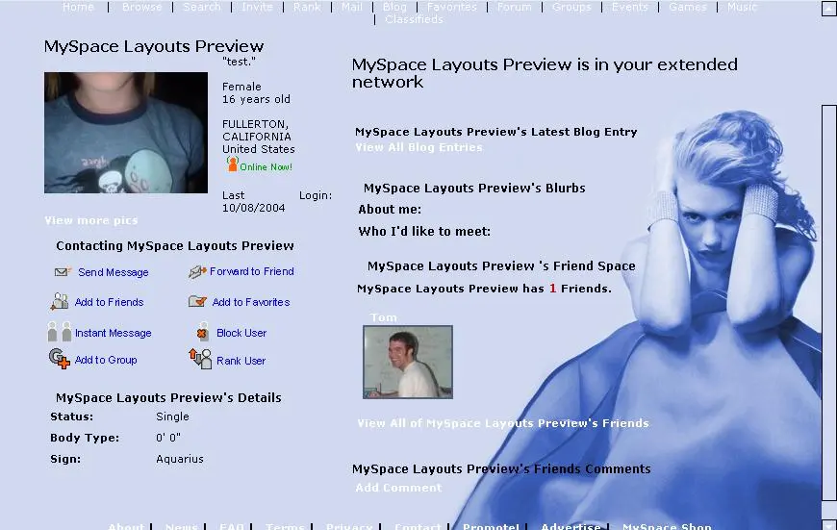
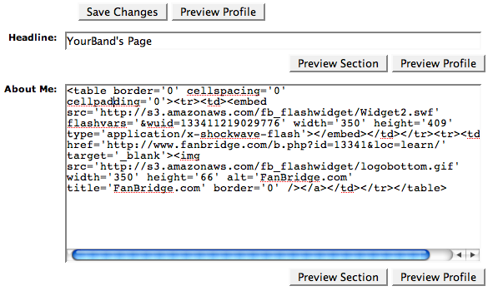
Why MySpace? Fortunately for My Space, their launch took place exactly when the most popular social network, Friendster, restarted having performance issues.

Slide 13
Why SQL Server?
Windows Platform, SQL servers
Rapid Development
One Instance of a server running on one server
Easy to modify and make changes of existing users.

Slide 14
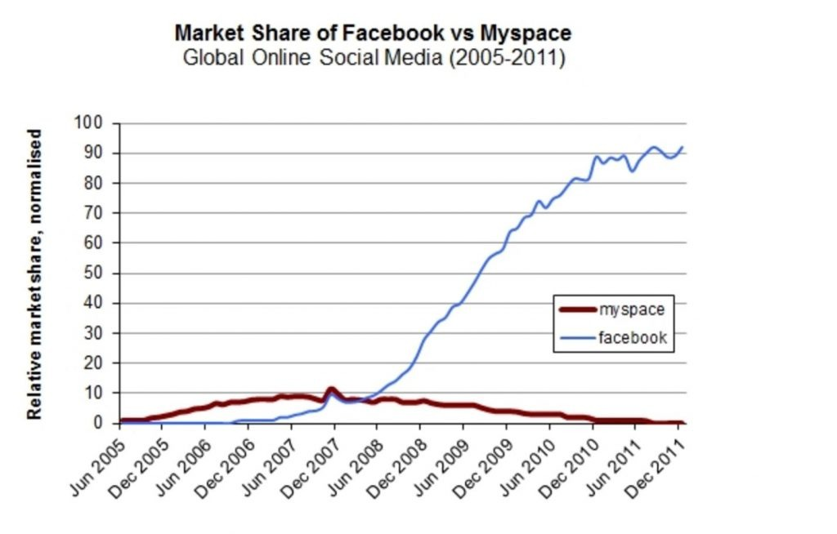
My Space Through Years...,

Slide 15
Architecture
The My-Space site ran on only two Dell servers (4 GB of memory and two processors) with a single database server.
As incoming requests grew, new web servers were purchased.
However, despite this, scaling problems started to show in early 2004.

Slide 16
Stable and Scalable… (Early stages)
The number of registered users reached 400,000
Master / slave model : One Major server and two slaves for backup(read or write)
Transactional Replication: Every transaction replicated to slaves.
Two- tier Architecture : Users and Webservers(which hit database servers)
Client- User Interface and server as server (2- tier Architecture model)

Slide 17
Partitioning
Until Mid 2004, when the number of users approached 2 million. At this point, the database server ceased to withstand the number of read-and-write requests (due to transactional replication).
So ,naturally , My space started to work on the next upgrade because the transaction went from being late to slow and even worser.
As an example, a simple comment posted took four to five minutes to be posted.

Slide 18
2 Million Users...
Imagine how popular myspace was, that within 4 months, despite significant delays, users grew up to 2 million.
Introduced idea of horizontal and vertical partitioning.

Slide 19
Storage Area Network(SAN) & Partitioning
They used a database architecture built around the concept of vertical partitioning, with separate databases for parts of the website that served different functions such as the log-in screen, user profiles and blogs.
Vertical Partitioning Scheme helped divide up the workload for database reads and writes alike, and when users demanded a new feature, My Space would put a new database online to support it.
My Space switched from using storage devices directly attached to its database servers to a storage area network (SAN), in which a pool of disk storage devices are tied together by a high-speed, specialized network, and the databases connect to the SAN. The change to a SAN boosted performance, uptime and reliability.

Slide 20
Failure of Partitions (Increased Users)
Around 3 million accounts and the vertical partitioning solution didn't last because they replicated some horizontal information like user accounts across all vertical slices. With so many replications one would fail and slow down the system.
Individual applications like blogs on sub-sections of the Web site would grow too large for a single database server. Reorganized all the core data to be logically organized into one database, split its user base into chunks of 1 million accounts and put all the data keyed to those accounts in a separate instance of SQL Server.
Moved to ASP.NET which used less resources than their previous architecture. 150 servers running the new code were able to do the same work that had previously required 246. Saw storage bottlenecks again. Implementing a SAN had solved some early performance problems, but now the Web site's demands were starting to periodically overwhelm the SAN's I/O capacity—the speed with which it could read and write data to and from disk storage.

Slide 21
Service Broker
In the early days of My Space, a lot of those data issues manifested themselves as errors on the site. There were big red X's showing up when data wasn't where it was supposed to be.
2005 SQL Servers launched with service broker , which gave an opportunity to communicate between databases at ease.
A big drawback was that the initial version was only a unicast version of Service Broker, which meant that a physical route had to be established between each service and each database.
When you're talking about an environment where a single database could potentially have to talk to several hundred databases, this created a maintenance problem.

Slide 22
Problems With Service Broker
Recovery time is cut down.
Worked on In-home Solutions.
Several times we had to rebuild replication; it took six hours. Meanwhile, transactions were still happening on the database; we ran out of transaction log space, and we nearly lost data.

Slide 23
Present Day...
Even though no one uses MySpace anymore, the website still exists, although not in the same avatar.
Now, it's populated with content about music artists, actors, TV shows, and movies, serving as a sort of entertainment website.
There are articles that people can read on the site, but the content comes from music magazine Spin. Unfortunately, it looks like there have been no new articles published on MySpace since March 2022.
Users can also browse artists and listen to music on MySpace, but a lot of the images on the website are broken and tracks don't seem to play when clicked. It's clear that the website isn't being maintained or updated.
MySpace doesn't even have an app for iPhone and Android, although users can access the mobile website if they really want to.
While the MySpace website still hasn't shut down, the platform as former users know it is pretty much dead.

Slide 24
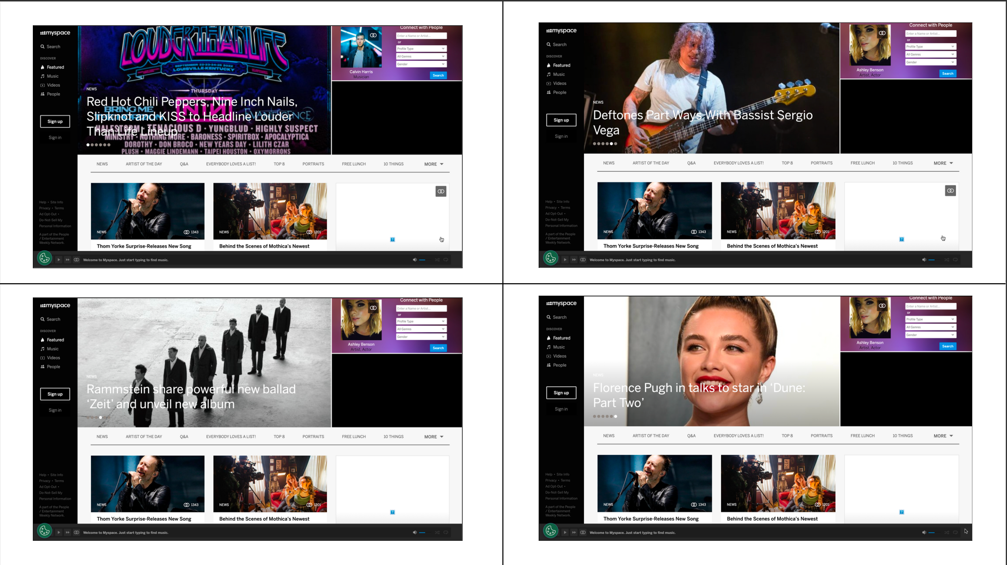

Slide 25
References
https://www.itprotoday.com/sql-server/myspace-answers-question-why-sql-server#close-modal
http://highscalability.com/myspace-architecture
https://www.codecademy.com/resources/blog/myspace-and-the-coding-legacy/
https://wiredelta.com/the-epic-tale-myspace-technical-failure/

Slide 26
Thank you!!!

